Slide 1
Dancing from Motion History Images (MHIs)
Robert Gross & Taylor Ripke
CSE 5524
Dr. Jim Davis

Slide 2
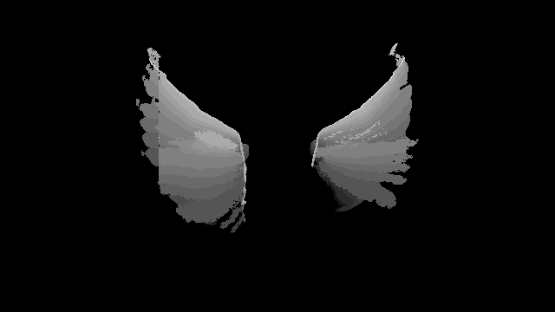
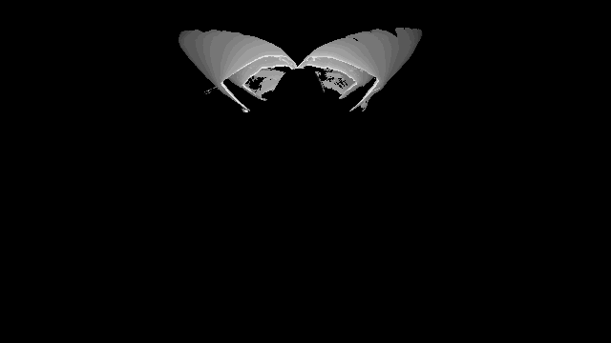
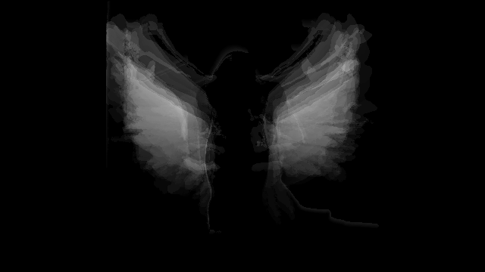
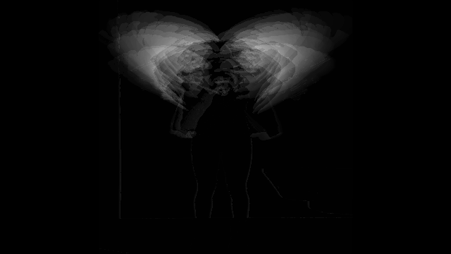
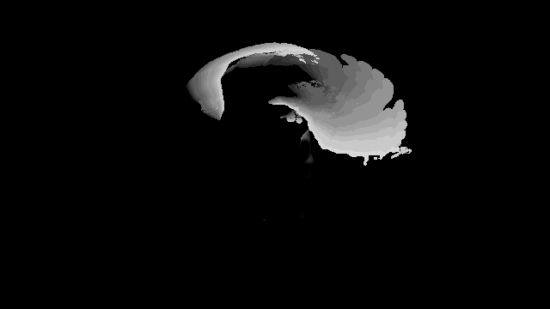
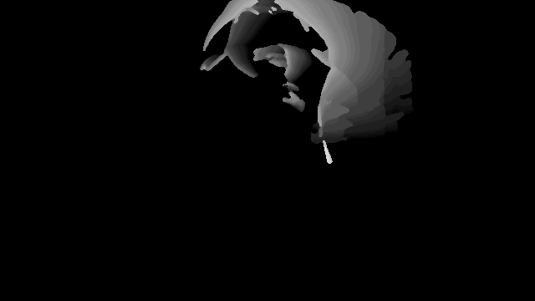
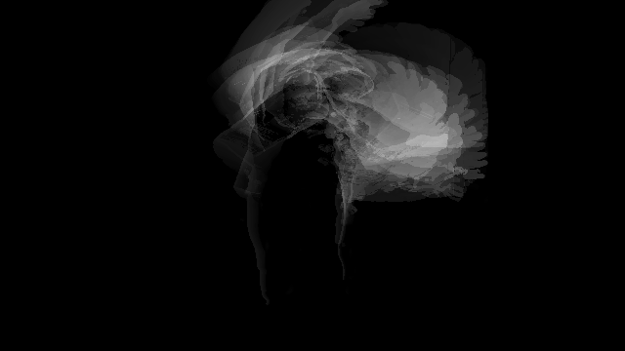
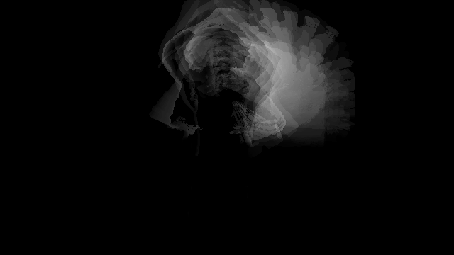
Pre-run: Generate Average/Individual MHI’s
Individuals
Average

Slide 3
Pre-run: Overview
Read in live video using VideoReader and process
Frame > Gray Frame > Resize (if needed) > Add to growing array > Compute individual MHI’s
Compute Average MHI
Read all images > Compute MHI
Filter Image (post-process)
Binarize > Median Filter > BW Area Filter > ImFill (holes) > Apply and Save

Slide 4
Individual Pixel Analysis
To determine a movement, pixel by pixel analysis is done.
Each of the individual MHI’s is used to compute the standard deviation for each pixel across those images.
For each pixel in the generated MHI during runtime, it is compared to the corresponding pixel in the average MHI image.
If it is within the standard deviation, a score counter is incremented. If that score is above a given threshold, the movement is detected.
Theoretically this approach should work because as long as the movements look similar, it should trigger within the standard deviation of the mean pixel.

Slide 5
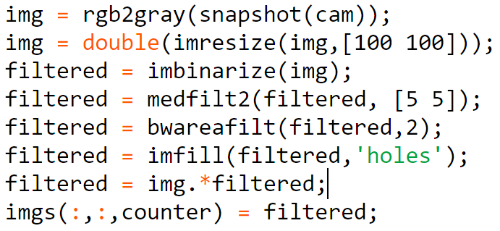
Step One:
Read Image > To Gray > Resize > Filter > Fill > Store

Slide 6
Step Two:
Determine movement
movementFound = determineMovement(imgs, move, counter, ySTD, mSTD, cSTD, aSTD, yAVG, mAVG, cAVG, aAVG, startFrom);
Backward looking window
We know the length of the longest / approximately how long each clip lasts.
For example, if we have 7 frames, we generate: 1:7, 2:7, 3:7, 4:7, etc
If it finds a letter, it returns. To determine the movement, we compute the error.
score = computeError(MHI, move, ySTD, mSTD, cSTD, aSTD, yAVG, mAVG, cAVG, aAVG);

Slide 7
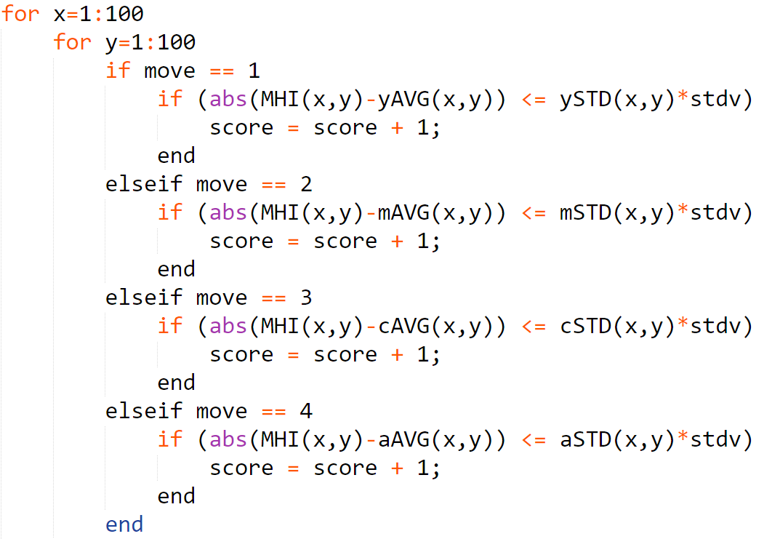
Step Three:
Given the generated MHI, run through the current MHI and the average MHI and determine if the given pixel is within one standard deviation of the other.

Slide 8
Step Four:
If a movement if found, start looking for the next immediately, generating a new MHI sequence.
If a movement is not found in x amount of time, start looking for the next move.

Slide 9
Results
Three variables:
Image scale
Threshold T for MHI
Threshold for detecting movement
In most cases, it was hard to detect the movement. It was either too sensitive or missed it all together.

